Slide 1

Object Oriented Programming
Ethereum : A new wave in Crypto-Currencies
MARUF RAHMAN

Slide 2
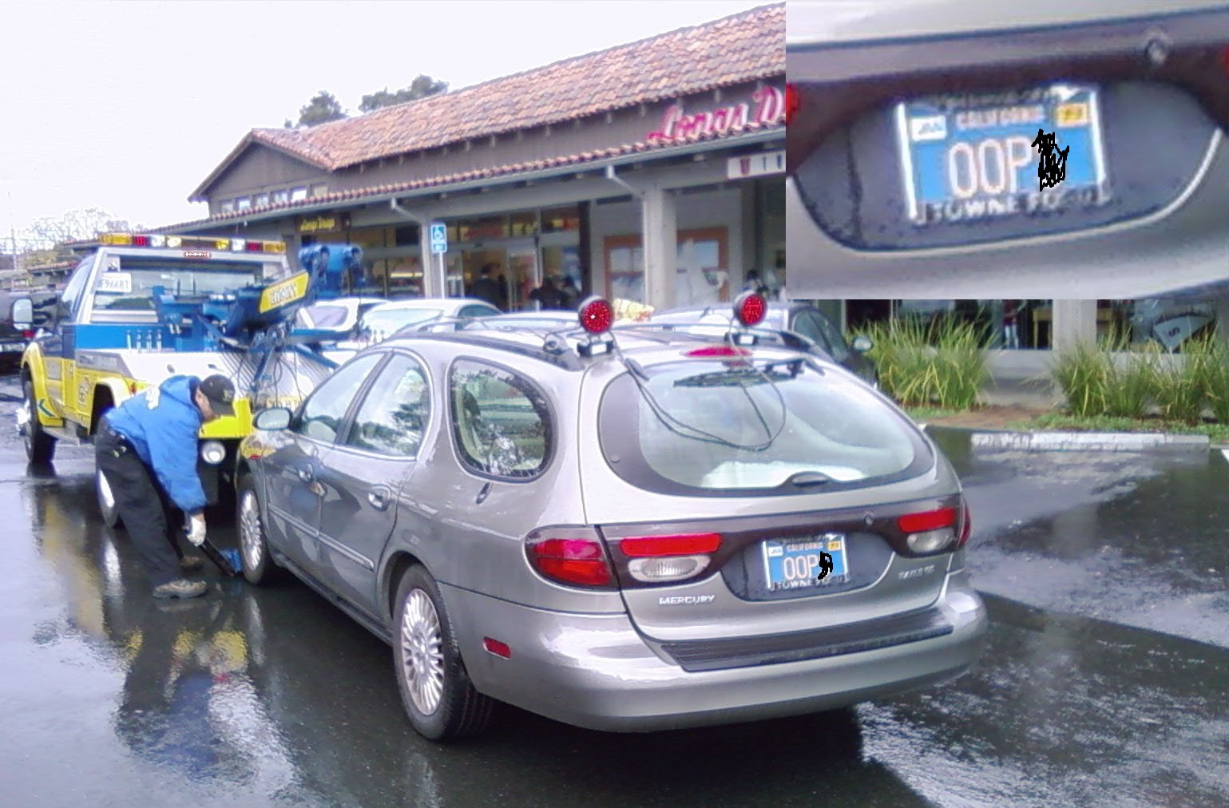
TYPES OF OOP
Abstraction ⟾ Encapsulation
Inheritance ⟾ Polymorphism

Slide 3
ABSTRACTION
The idea of abstraction is to exist as an idea instead of physically. Mainly, it involves hiding details of how the object works from the user. Hiding details of how the object works from the user. For example an Ethereum Miner doesn't need to know much about what kind of codes it will process, which audio-video encodings will be involved, how ethernet works, or the overall power factor of its data center. Abstraction is the ability to simultaneously say "all that stuff is somebody else's problem" while not breaking things.

Slide 4
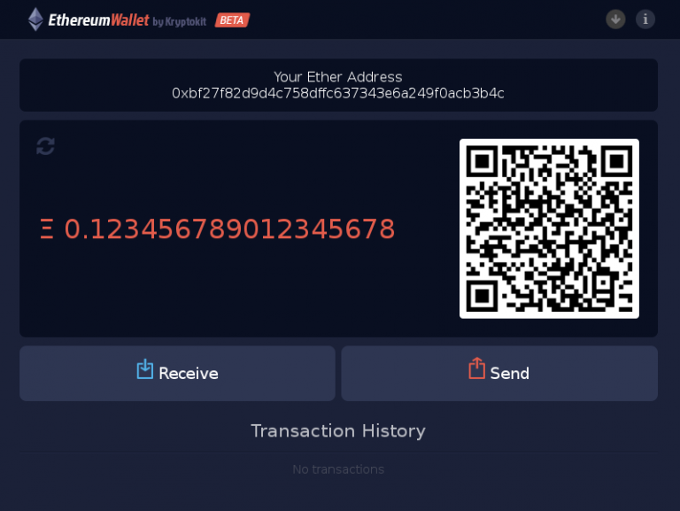
ABSTRACTION
For Example: When you start mining for Ethereum Coins with a dedicated miner, Ethereum coins are immediately mined and stored onto your personal wallet. It is not seen how this process is automatically accomplished, however results are shown without knowing how it does so.

Slide 5
Encapsulation
The whole idea behind encapsulation is to hide the implementation details from users. It’s about drawing a boundary between "data that I'll take care of here" and "data that everyone else will have to know about."
If a data member is private it means it can only be accessed within the same class. No outside class can access private data member (variable) of other class.

Slide 6

Encapsulation

Slide 7
Encapsulation
For example, the Ethereum Miner Client (The Software that includes the mining program)
knows the nitty-gritty details of Block code data (and how to decode the data to obtain ETH), but all you see is a simple Command prompt with a user friendly interface. You don't have to know anything about decrypting block code data to produce ETH, because the details are encapsulated by Miner client.

Slide 8
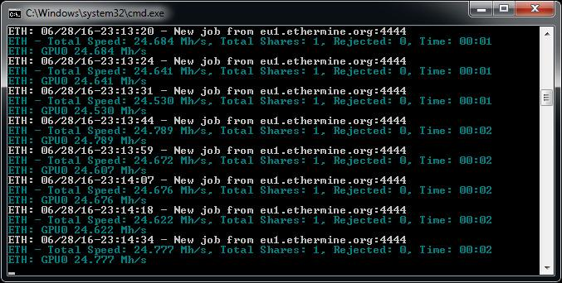
Encapsulation

Slide 9
Inheritance
We can define inheritance as the instruction set where one class obtains the properties of another class, such as methods and fields. The resulting information is made manageable in a ranking order, with this use of inheritance. The class which obtains the properties of the other class is known as the child chass (subclass), while the class which properties are inherited is known as base class (parent class).
You could say that Inheritance is quite a bit similar to evolution. For example, you could say that wolf-like ancestors could be the parent class of all the different breeds of dog around the world. Inherited properties such as the number and size of legs and the type of fur, and other behaviours such as barking or eating.

Slide 10
Inheritance
In terms of Ethereum, there are in fact two different types of Ethereum. One is the original ethereum currency, ETC (Ethereum Classic). In mid 2016, the ethereum network was compromised, and millions of dollars worth of ethereum was stolen. In response, the Founders of Ethereum introduced an improved, more secure Ethereum Currency, called ETH which was a evolution of ETC. In this case the properties of the Child class (ETH) was derived from the parent class (ETC).
We can call Ethereum the base class, while the methods needed to obtain Ethereum as the child class.

Slide 11
Polymorphism
Polymorphism is an object-oriented programming concept that refers to the ability of a variable, function or object to take on multiple forms.
Polymorphism in simple terms, it’s the idea that sometimes you can alter the formatting and meaning of information but still be able to use the same instructions.
This mainly concerns about properties and particularly behaviours being overridden. So think Or, having one type of data act like another. Inheritance comes to mind. If say, Item A inherits from B. Then any piece of code that takes a "B" item can also take an "A" object. Because all traits and behaviors of B are available in A.

Slide 12
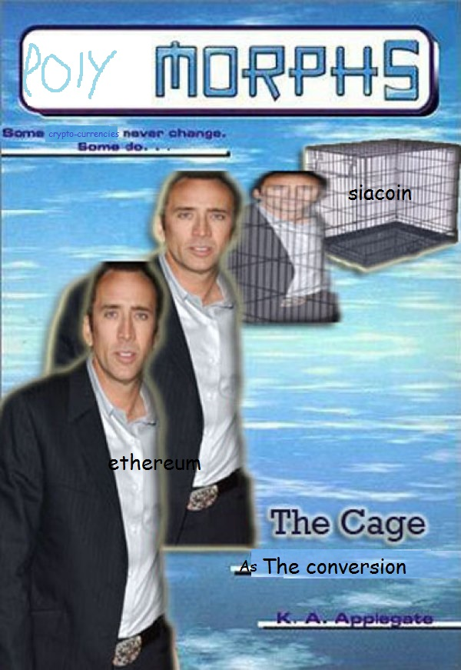
Polymorphism

Slide 13

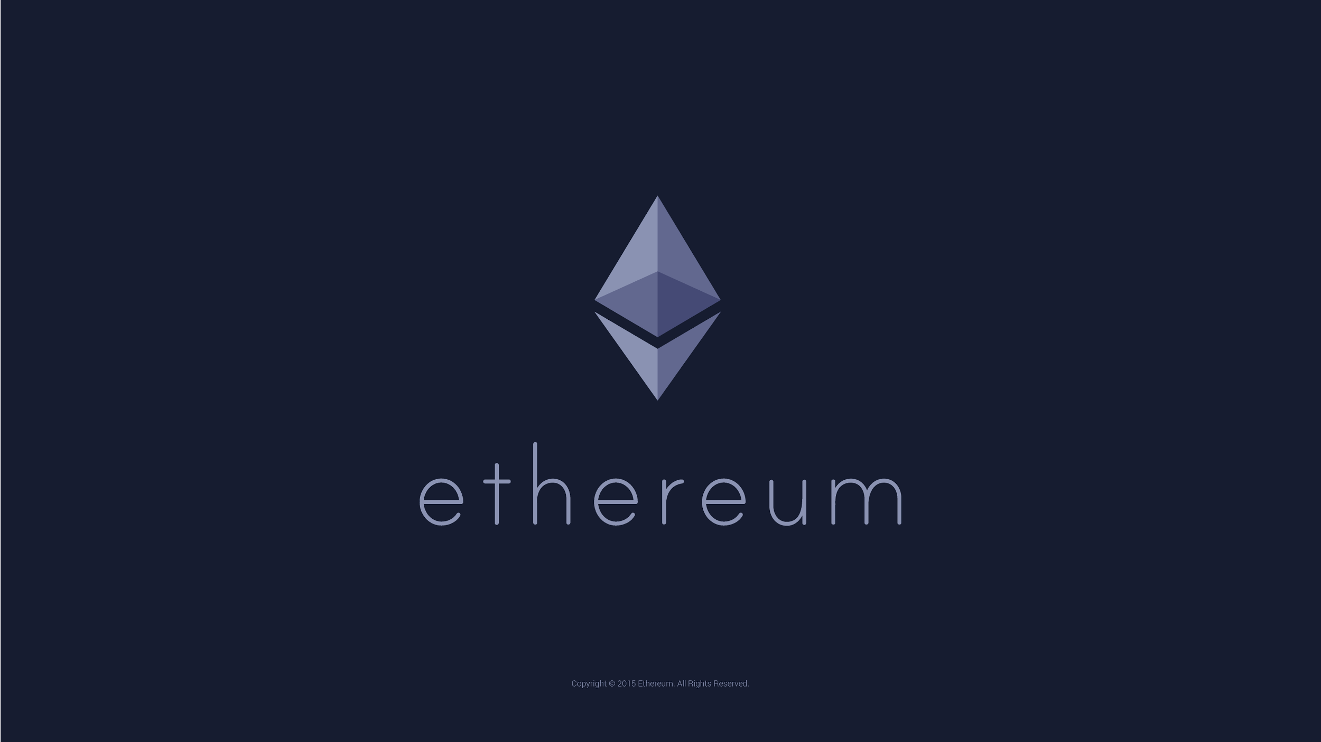
Polymorphism
There is a popular Ethereum Miner called “Claymore’s Dual Miner”. This miner is popular because, it has the ability to mine Ethereum, and another Crypto Currency called Siacoin. Siacoin is a currency that is based upon Ethereum. Its basic underlying code structure is similar to Ethereum, and thus the Mining client program, is easily able to mine both as Siacoin is the child class of Ethereum. So, functions that work on parent classes (Ethereum) should also work on Child classes (Siacoin)

Slide 14

Interface
This is the connection between the two systems which connects their interfaces together. Interfaces allow you to use something without knowing how it works, or what it does. In the Ethereum Network, we use the Miner client on the local miner PC, to connect to the global mining pool (The network which issues the block code data). The internet connection, which is used to connect two Mining systems together will be used as the interface.

